Slide 1
Computer Vision
Part 1: Image Processing in Computer Vision
ADF – Start 08:30

Slide 2
How Our Eyes See
Computer Vision

Slide 3
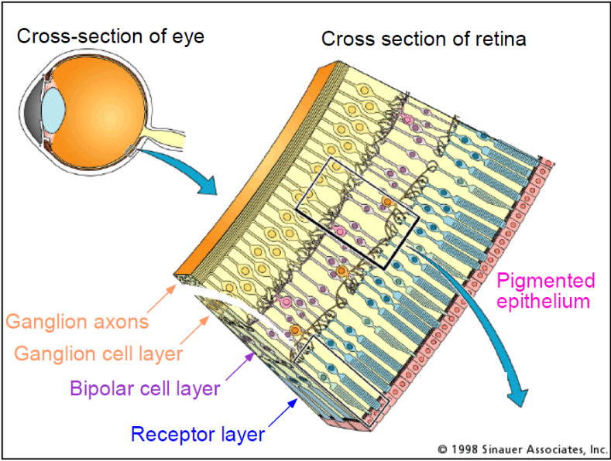
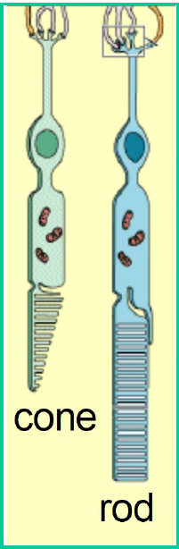
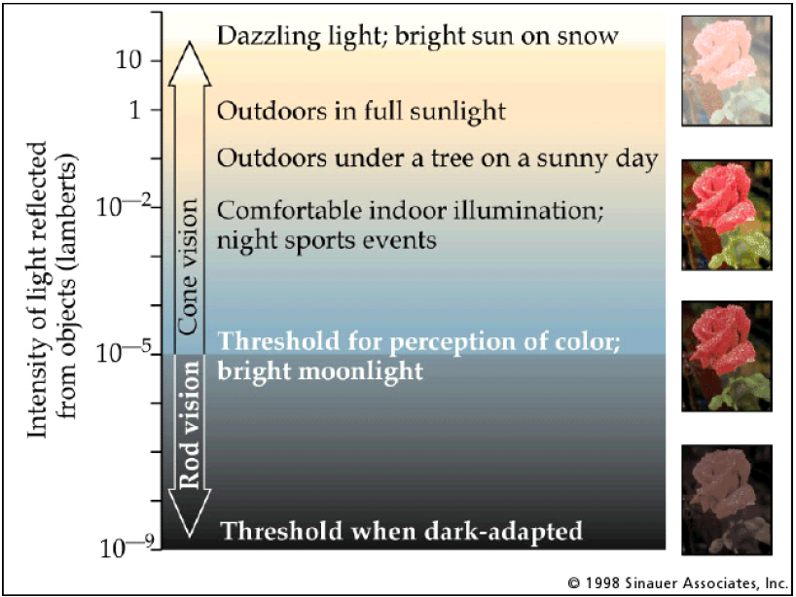
Our Eye
Computer Vision

Slide 4
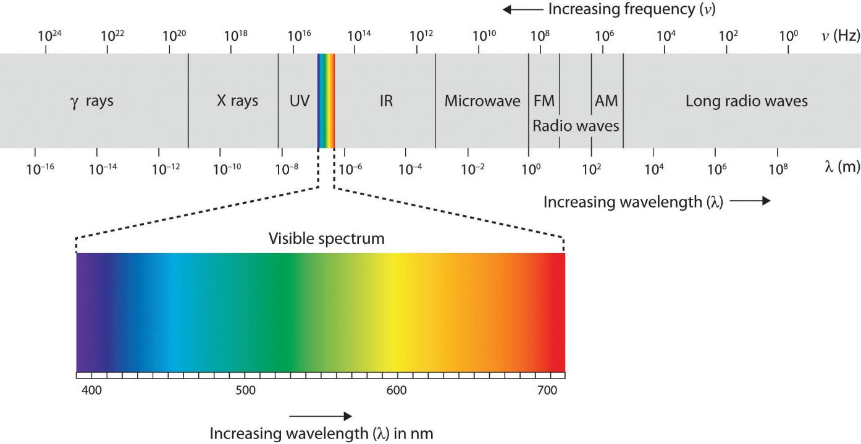
Electromagnetic Spectrum
Computer Vision

Slide 5
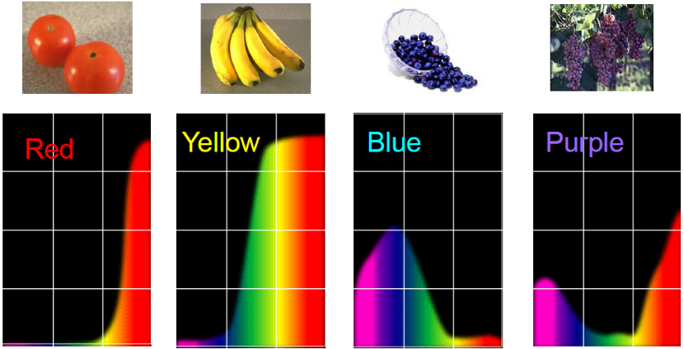
The Physics of Light
Computer Vision

Slide 6
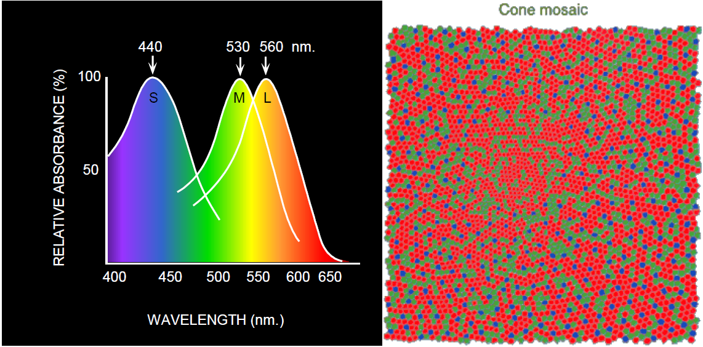
The Physics of Light
Computer Vision
Notes:
The three sorts of cone present in the retina (also named S, M and L for short/medium/long wavelength) do not detect one specific color each. Cones send a nervous signal when they detect light, and the strength of that signal is determined by the wavelength of the light according to spectral sensitivity
curves:

Slide 7
Digital Image
Computer Vision

Slide 8
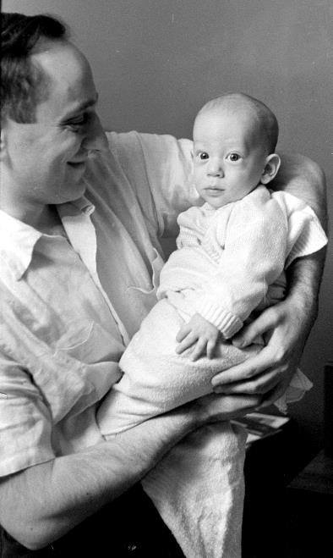
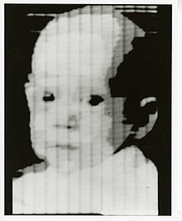
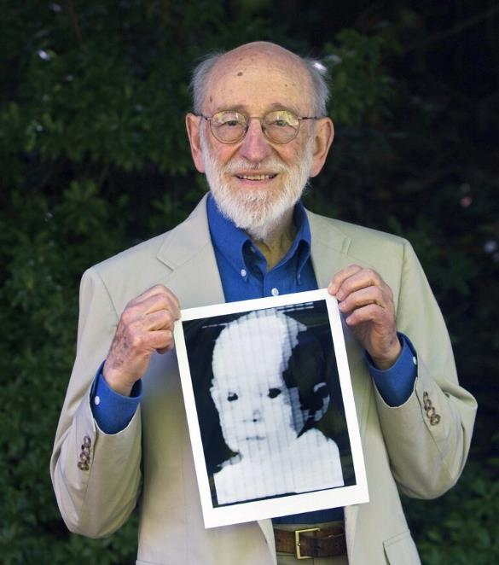
First Digital Photograph Ever Made
176x176 pixels
Russell Kirsch, 1957
Computer Vision

Slide 9
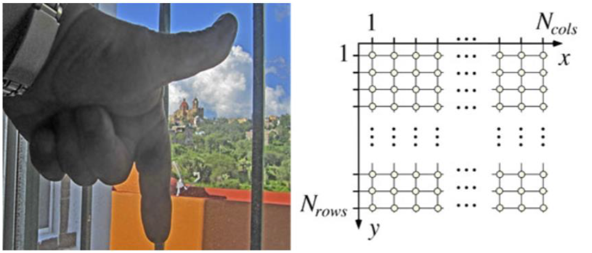
Digital Image
A digital image is defined by integrating and sampling continuous (analog) data in a spatial domain [Klette, 2014]
Computer Vision

Slide 10
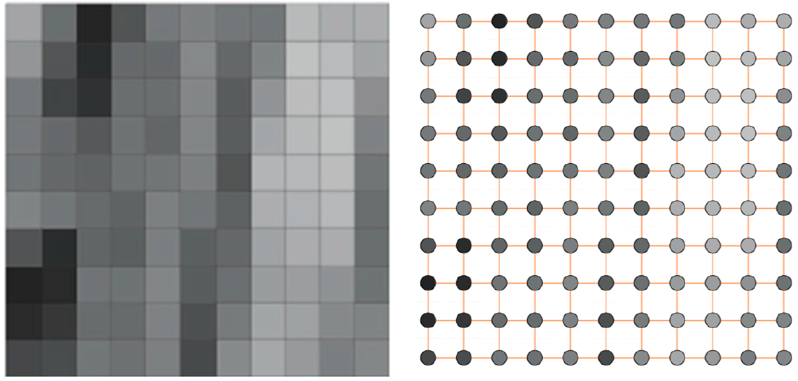
Picture Element
Atomic elements of an image [1960]
Computer Vision

Slide 11
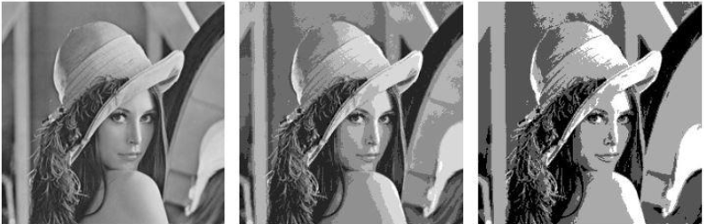
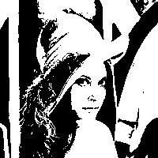
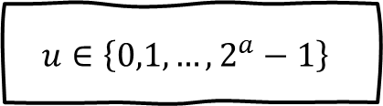
Scalar (Gray) and Binary Image
$$u∈\left\{0,1,…,2^{a}−1\right\}$$
0 black, 255 white
0 black, 1 white
a=8
256 colors
a=3
8 colors
a=2
4 colors
a=1
2 colors
Computer Vision

Slide 12
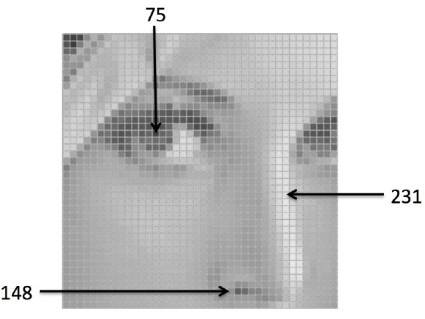
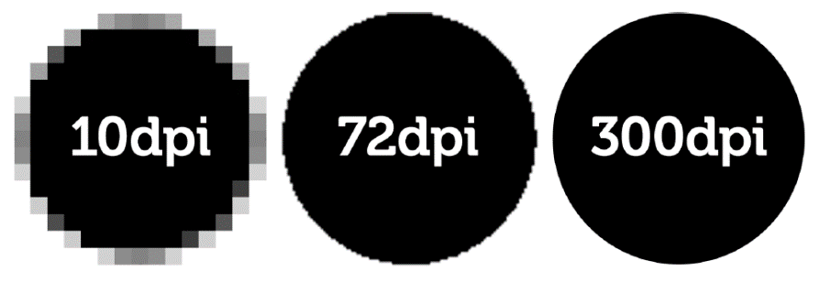
Resolution
Display Parameter
Dots per Inch (DPI)
Computer Vision

Slide 13
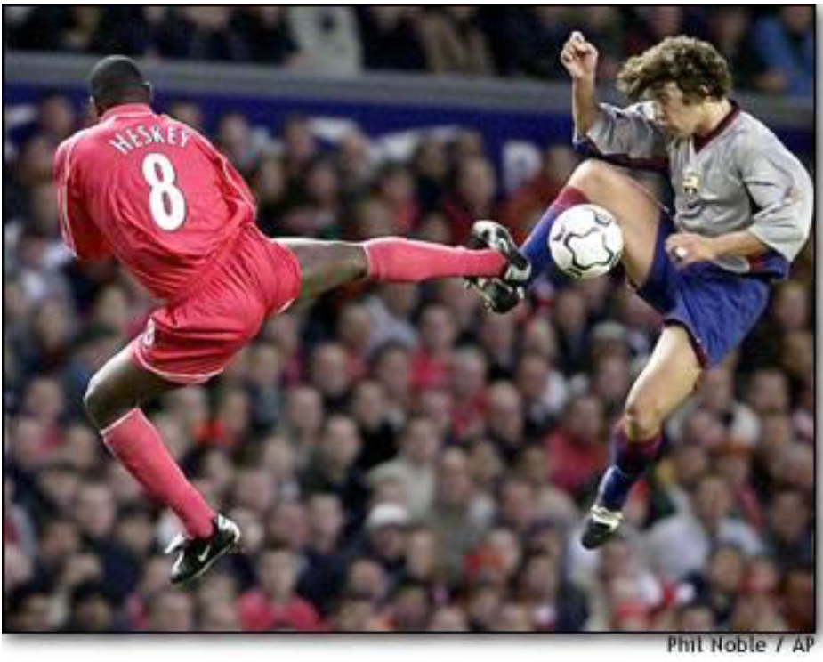
Color Image
Computer Vision

Slide 14

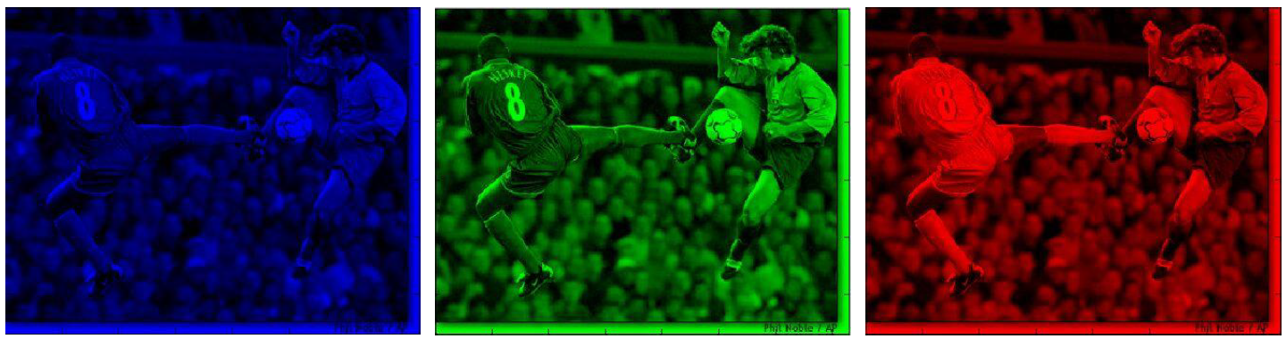
Color Image
Computer Vision

Slide 15
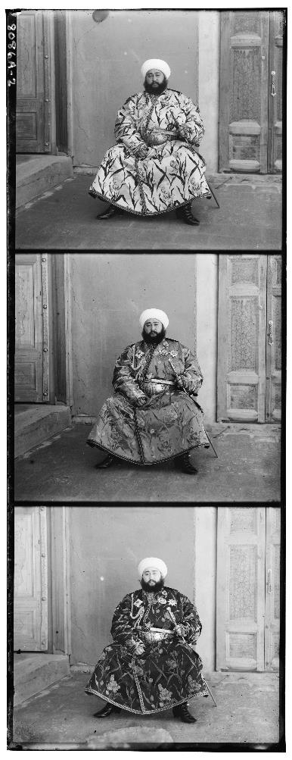
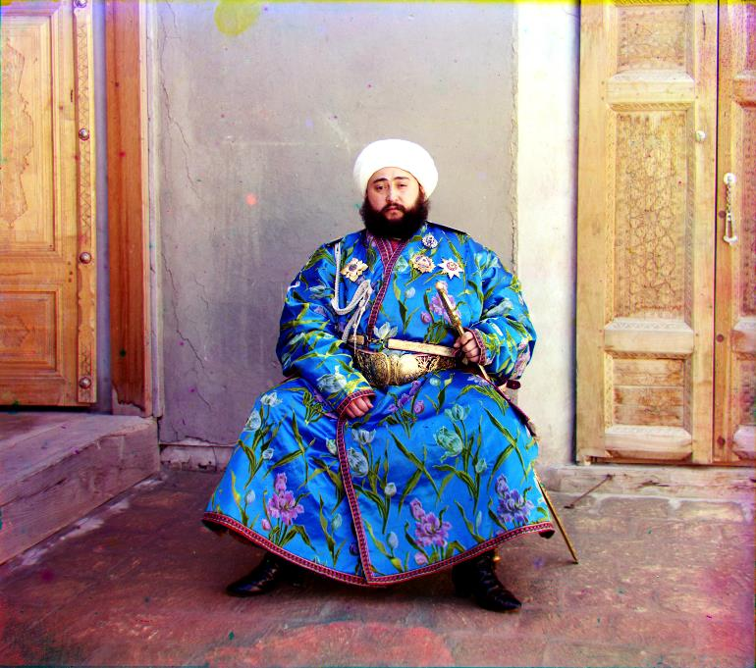
Color Photograph
Computer Vision
Notes:
Prokudin-Gorskii, Sergei Mikhailovich, 1863-1944, photographer. “The Bukhara Emir”. Prints and Photographs Division, Library of Congress, Reproduction number: LC-P87-8086A-2

Slide 16
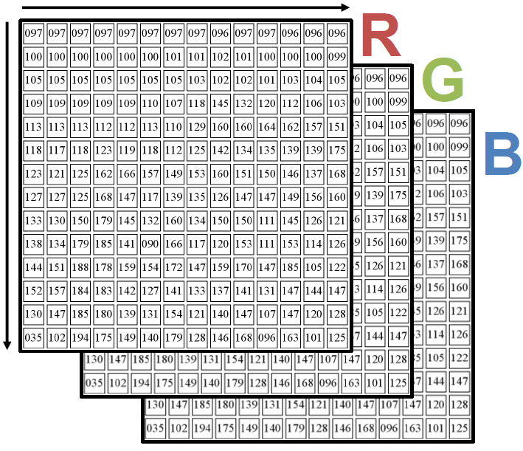
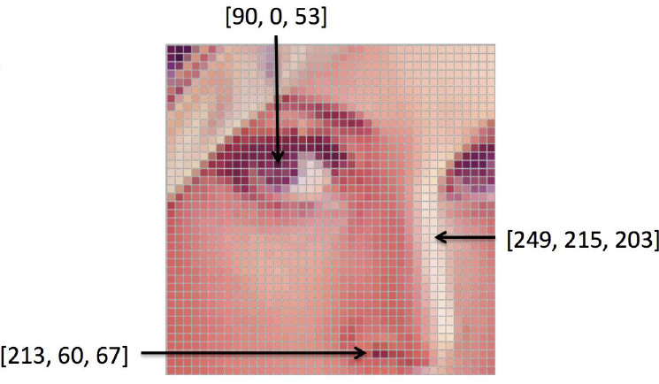
Images in Python
Computer Vision

Slide 17
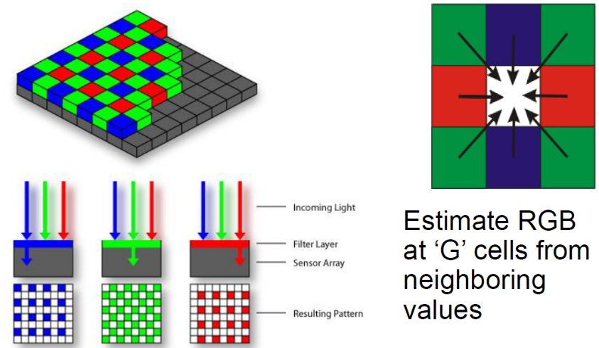
Pixel Display
Computer Vision
Notes:
The cones in our eye are not RGB. The RGB system is just a hack that use the limits of our visual system to display coloured images in a technically practical way.

Slide 18
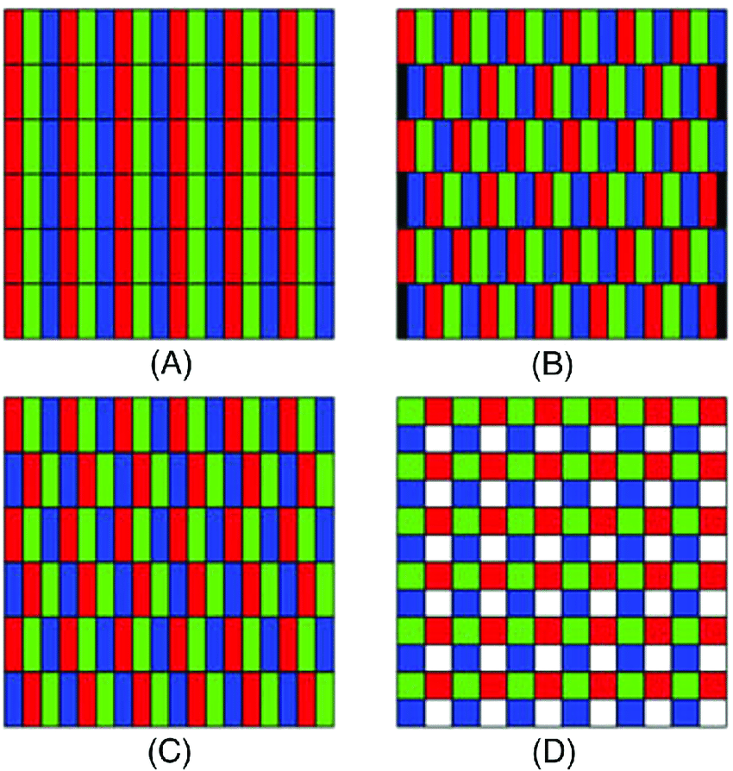
Pixel Geometry
Computer Vision
Notes:
(a) RGB vertical stripe display LCD, (b) RGB delta CRT, (c) VPX (with three subpixels/pixels), and (d) VPW (with four subpixels/pixels). [9]

Slide 19
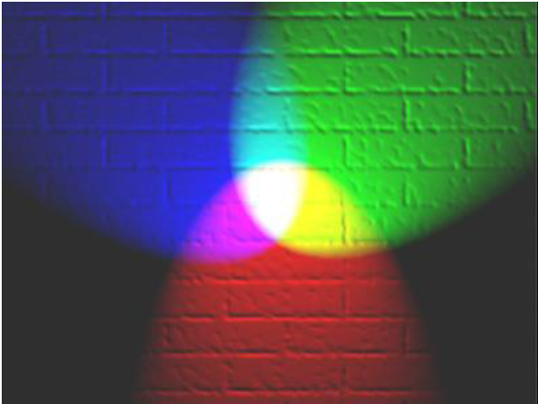
Representing Colored Light
Computer Vision

Slide 20
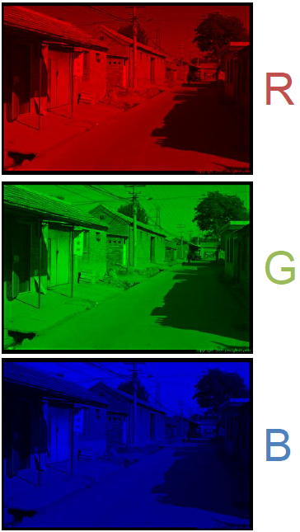
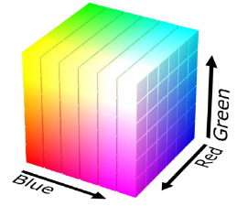
RGB Format
Pros
Simple, Common
Cons
Distances don’t make sense
Correlated
Computer Vision

Slide 21
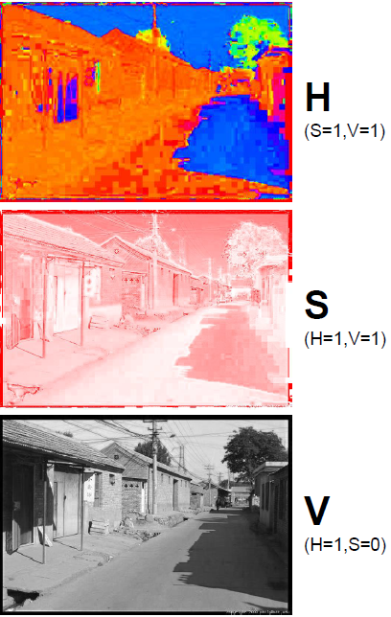
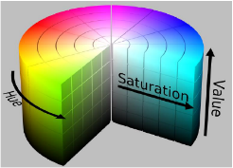
HSV Format
Pros
Intuitive for picking colors
Sort of common
Fast to convert
Cons
Not as good as other better spaces
Computer Vision

Slide 22
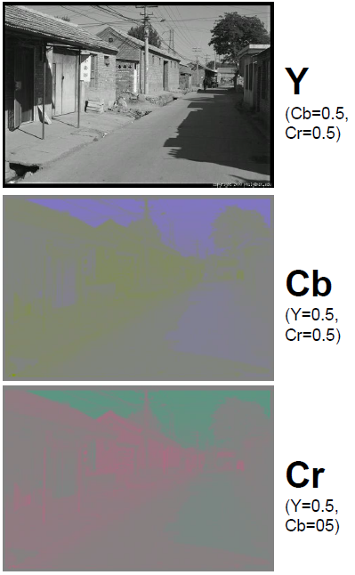
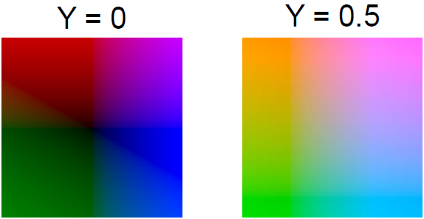
YCbCr/YUV Format
Pros
Great for transmission / compression
Cons
Not as good as other better smart color spaces
Computer Vision

Slide 23
Which format to use?
RGB : sort of intuitive, standard, everywhere
HSV : good for picking, fast to compute
YCbCr /YUV : fast to compute, compresses well
Pick based on what you need and don’t sweat it
color really isn’t crucial
Computer Vision

Slide 24
Classical Image Processing for Computer Vision
Computer Vision

Slide 25
3 Overlapped Fields
Image Processing
Image
Image
Computer Graphics
Pattern Recognition
Description
Description
Computer Vision

Slide 26
Image Processing
Improved visual information for Human Interpretation
Storage, transmission and representation for Machine Perception automation
Emphasizes the procedure for extracting image information
Computer Vision

Slide 27
Image Processing Examples
Computer Vision

Slide 28
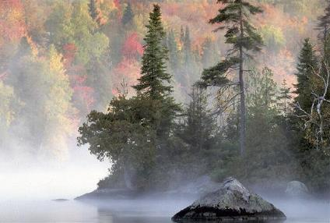
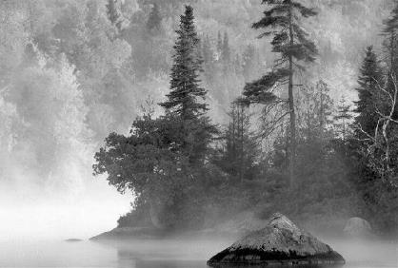
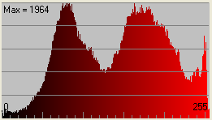
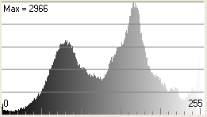
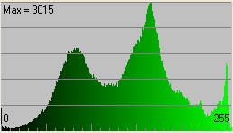
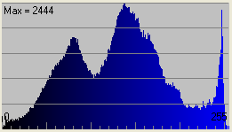
Image Histogram
Computer Vision

Slide 29
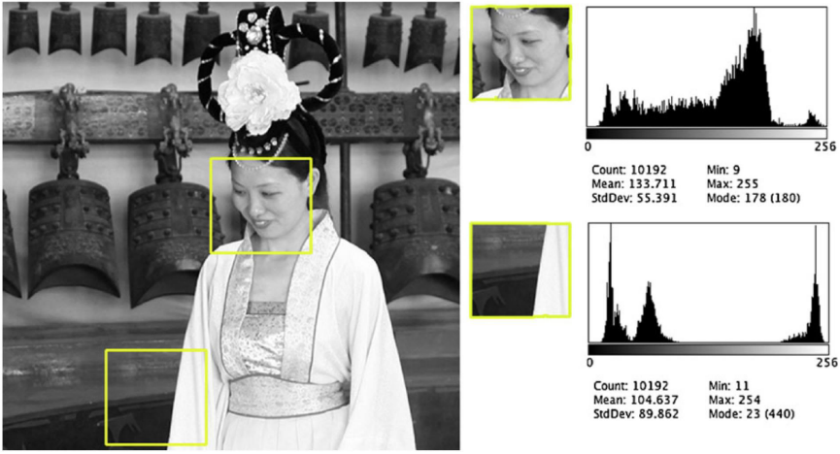
Image Histogram
Computer Vision

Slide 30
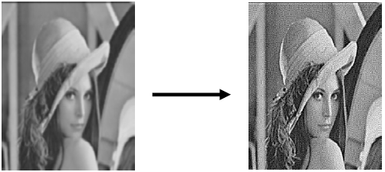
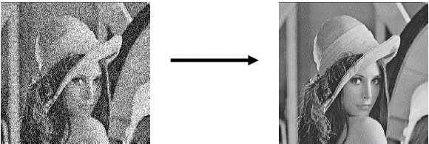
Image Enhancement
Noise Filtering
Sharpening
Computer Vision

Slide 31
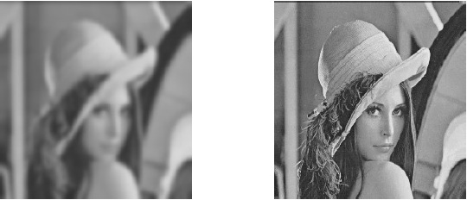
Image Restoration
Deblurring
Computer Vision

Slide 32
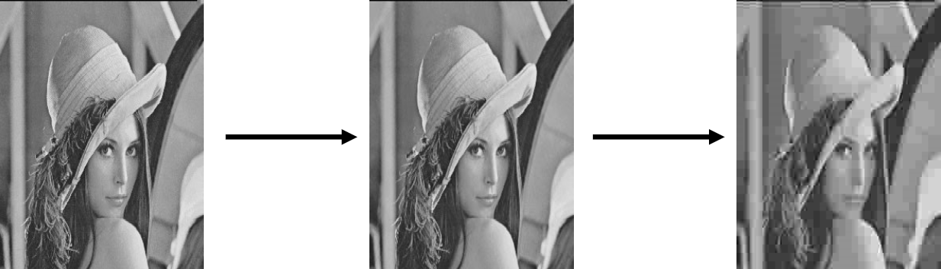
Image Compression
bitmap
JPEG 80%
JPEG 20%
Computer Vision

Slide 33
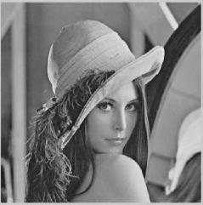
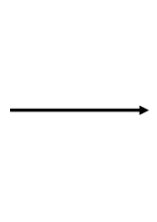
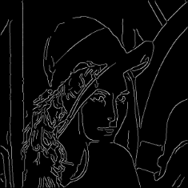
Image Analysis
Edge Detection
Computer Vision

Slide 34
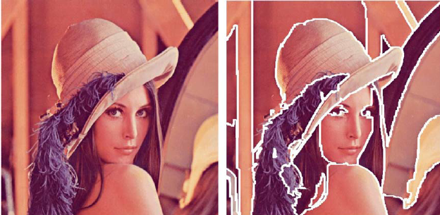
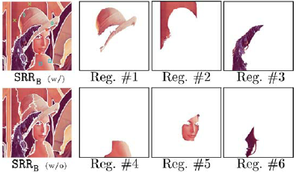
Image Segmentation
Computer Vision

Slide 35

Break, Question?
Computer Vision

Slide 36
Why Image Processing
Computer Vision

Slide 37
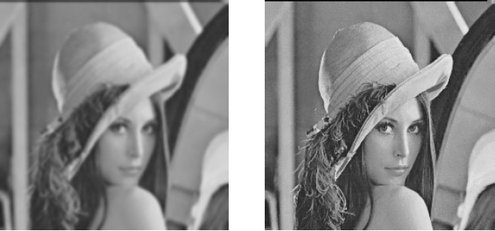
Human Viewpoint
Processing an image so as to produce an image that matches our expectations, or the quality is better
Computer Vision

Slide 38
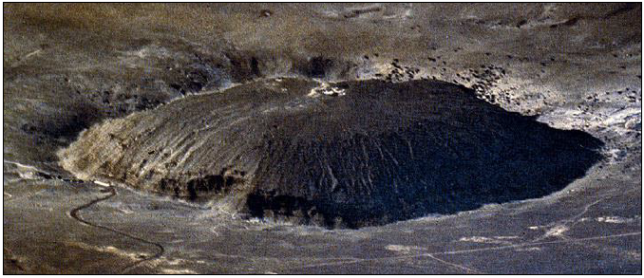
Optical Illusion and Ambiguity
Computer Vision

Slide 39
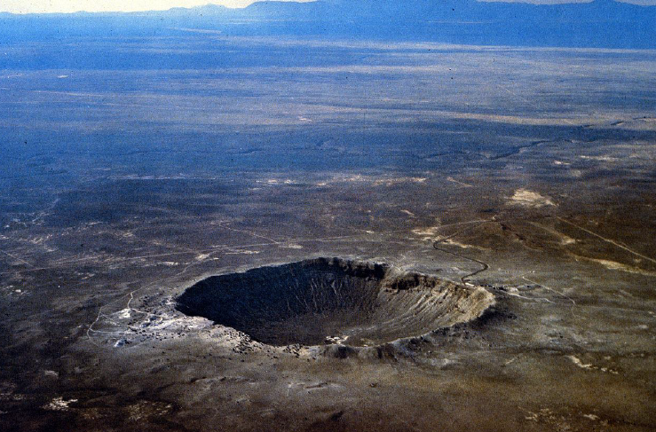
Ambiguity
Humans assume light from above (and the blueness also tells you distance)
Computer Vision

Slide 40


Optical Illusion and Ambiguity
Computer Vision

Slide 41


Optical Illusion and Ambiguity
Computer Vision

Slide 42

Optical Illusion and Ambiguity
Computer Vision

Slide 43
When to use Image Processing
Image repair or modification to improve visual quality or highlight some aspects of the information contained in the image
Elements in the image need to be grouped, matched or measured
Some images need to be combined with other parts of the image.
Computer Vision

Slide 44
Process in Computer Vision
Process level | Example Algorithm
Image Acquisition | Representation, Acquisition, Sampling, Quantification, Compression
Preprocessing, Image-to-image Transformation | Noise Removal, Contrast Enhancement Edge Detection, Restoration
Lowest-level Feature Extraction | Texture Detection, Segmentation
Intermediate-level Feature Extraction, Image-to-parameter Transformation | Pattern Matching, Feature Selection
High-level scene interpretation, Pattern-to-Decision Transformation | Model-based Recognition
Image Processing
Image Analysis
Computer /Robot Vision
Computer Vision

Slide 45
Modern Image Processing for Computer Vision
Computer Vision

Slide 46
Classical Computer Vision
Model capabilities are limited
Mostly handcrafted algorithms and techniques
Limited data, synthetic images
Only works in a controlled environment
Need to preprocess the image to help recognition
Computer Vision

Slide 47
Modern Computer Vision
Higher Model capabilities
Works better with more data (Neural Net Family)
Carelessly preprocessing images may turn the data too sterile
Leads to Overfitting
Increase the image variation to simulate the real-world condition
Computer Vision

Slide 48

Modern Computer Vision
Computer Vision

Slide 49

Classic
Deep Learning
Feature Extractions
model
c-Class scores
training
End-to-end learning model
c-Class scores
training
Computer Vision

Slide 50
Data Availability
Computer Vision

Slide 51
Data Availability
Curse of Dimensionality
The higher the dimensions of a data, the more data is needed to represent the distribution
Deep Learning
To improve the performance of Deep Neural Networks, more data is needed for the training process
Computer Vision

Slide 52
Data Availability
Deep Neural Networks
performance
Medium Neural Networks
Shallow Neural Networks
Traditional Machine Learning
1990s
data
Computer Vision

Slide 53
Data Augmentation
Computer Vision

Slide 54


Data Augmentation
“cat”
Compute loss
Transform it in some way
Model
Computer Vision

Slide 55

Data Augmentation
10 20 30 40 50 60 70 80 90 10 20 30 40 50 60 70 80 90 10 20 30 40 50 60 70 80 90 10 20 30 40 50 60 70 80 90 10 20 30 40 50 60 70 80 90 10 20 30 40 50 60 70 80 90 10 20 30 40 50 60 70 80 90 10 20 30 40 50 60 70 80 90 10 20 30 40 50
10 20 30 40 50 60 70 80 90 10 20 30 40 50 60 70 80 90 10 20 30 40 50 60 70 80 90 10 20 30 40 50 60 70 80 90 10 20 30 40 50 60 70 80 90 10 20 30 40 50 60 70 80 90 10 20 30 40 50 60 70 80 90 10 20 30 40 50 60 70 80 90 10 20 30 40 50
Artificially expand the training set
Change the pixels without changing the label
Train on transformed data
VERY widely used
10 20 30 40 50 60 70 80 90 10 20 30 40 50 60 70 80 90 10 20 30 40 50 60 70 80 90 10 20 30 40 50 60 70 80 90 10 20 30 40 50 60 70 80 90 10 20 30 40 50 60 70 80 90 10 20 30 40 50 60 70 80 90 10 20 30 40 50 60 70 80 90 10 20 30 40 50
Computer Vision

Slide 56
Data Augmentation – Horizontal Flips
Simplest way
Computer Vision

Slide 57
Data Augmentation – Crops and Scales
Randomly crop image and resize it
training
Sample random crops/scales
testing
Average a fixed set of crops
Computer Vision

Slide 58


Data Augmentation – Color Jitter
Simple :
Randomly jitter contrast
Complex:
Apply PCA to all [R,G,B] pixels in training set
Sample a “color set” along the PC directions
Add offset to all pixels of a training image
Computer Vision

Slide 59

Data Augmentation – Get Creative!
Random mix/combinations of:
Translation
Rotation
Stretching
Shearing
Lens distortions
Etc.… (go crazy)
Computer Vision

Slide 60

General Theme
Example Case | Horizontal Flip | Vertical Flip | Rotate | Shift | Zoom | Color Jitter
Autonomous Car | ✓ |  | ±10° | high | high | ✓
Aerial view object recognition | ✓ | ✓ | 180° | high | high | ✓
Face Recognition |  |  | ±15° | low | low | ✓
X-Ray image Recognition |  |  | ±5° | tiny | tiny
Etc.
Computer Vision

Slide 61
Data Augmentation: Takeaway
Simple to implement Use It!
Especially useful for small datasets
Fits into framework of noise / marginalization
Computer Vision

Slide 62
Data Augmentation: Takeaway
Not directly improve performance
Similar to Dropout, Regularization, etc
Main purpose is to prevent overfitting
Augmentation: by increasing the data variation
Dropout: distribute neuron activation
Regularization: manipulate the weights distribution
Computer Vision

Slide 63
Data Augmentation Library
datagen = ImageDataGenerator(
# set input mean to 0 over the dataset
featurewise_center=False,
# set each sample mean to 0
samplewise_center=False,
# divide inputs by std of the dataset
featurewise_std_normalization=False,
# divide each input by its std
samplewise_std_normalization=False,
# apply ZCA whitening
zca_whitening=False,
# epsilon for ZCA whitening
zca_epsilon=1e-06,
# randomly rotate images in the range (degrees, 0 to 180)
rotation_range=0,
# randomly shift images horizontally (fraction of total width)
width_shift_range=0.1,
# randomly shift images vertically (fraction of total height)
height_shift_range=0.1,
# set range for random shear
shear_range=0.,
# set range for random zoom
zoom_range=0.,
# set range for random channel shifts
channel_shift_range=0.,
# set mode for filling points outside the input boundaries
fill_mode='nearest',
# value used for fill_mode = "constant"
cval=0.,
# randomly flip images
horizontal_flip=True,
# randomly flip images
vertical_flip=False,
# set rescaling factor (applied before any other transformation)
rescale=None,
# set function that will be applied on each input
preprocessing_function=None,
# image data format, either "channels_first" or "channels_last"
data_format=None,
# fraction of images reserved for validation (strictly between 0 and 1)
validation_split=0.0)
# Compute quantities required for feature-wise normalization
# (std, mean, and principal components if ZCA whitening is applied).
datagen.fit(x_train)
# Fit the model on the batches generated by datagen.flow().
model.fit (datagen.flow(x_train, y_train,
batch_size=batch_size), epochs=epochs,
validation_data=(x_test, y_test), workers=4)
Popular libraries such as Keras already provide a mechanism for the training process with Data Augmentation
Data is manipulated and transformed "on-the-run" during the training process
Computer Vision

Slide 64
Question?
Computer Vision

Slide 65

Next Agenda
Filtering
Edge Detection
Computer Vision

Slide 66
References
Fei-Fei Li, Andrej K, Justin J - Stanford CS231n 2016 Course
Fei-Fei Li, Justin J, Serena Y - Stanford CS231n 2018 Course
Grauman, K. and Leibe, B. 2011. Visual Object Recognition. Synthesis Lectures Artif. Intell. Mach. Learn. 5, 1 181
Computer Vision

